Slide 1
South Africa in AGOA: Impact and Renewal
TIPS Development Dialogue
Presentation by Saul Levin
June 2024
With acknowledgement to Chris Wood
(lead researcher on the project)

Slide 2
Overview
AGOA provides benefits for South Africa, and increasing over time
Benefits are largely in agricultural and manufactured exports from SA to USA (& very beneficial for specific products – wine, citrus, nuts, ice-cream, certain chemicals)
There are risks to non-continuation of AGOA (it expires in 2025 and needs to be renewed)
  Overall trade between USA and SA has been growing in the past decade, including products under AGOA
  South Africa has been one of the few countries to see the benefits from AGOA (especially non-petroleum exporters) but more can be done
  AGOA is an important part of USA trade policy with respect to Africa (even though it is unilateral)
  The benefits of AGOA have not been fully utilised
  Exporting to the USA is complex and difficult for exporters

Slide 3
OVERALL TREND
SA Exports via AGOA accounted for 21% of total exports to the United States in 2022, with AGOA exports surpassing USD 3 billion for the first time (AGOA + GSP 25% in 2022)
On average, AGOA accounted for 16% of SA – USA exports over the past five years This figure undersells the importance of AGOA, due to the presence of very large commodity exports from SA to the US – which don’t typically benefit from preferences.
Utilisation of AGOA is much higher for value added sectors, with 75% of agriculture and 59% of manufacturing exports utilising the preferences.

Slide 4
TARIFF BENEFIT
South African exports via AGOA reduced customs duties by approximately USD 99 million (ZAR 1,8 billion) in 2022
Companies avoided USD 566 million (ZAR 10,4 billion at 2022 rates) in tariffs over the last ten years.
This direct cost almost certainly undersells the benefit of AGOA, given that many of the benefits result from the competitiveness impact
The total cost in foregone tariffs from trade with South Africa equivalent to 0.0000165% of the US Federal Government spending in 2022.

Slide 5
COMPETITIVENESS BENEFIT
$$Revealed preference= \frac{Country import volume}{Total import volume}= \frac{Preference margin}{\left(Price+Tariff\right)}$$
In order to estimate the impact of a loss of competitiveness, an assessment was designed utilising a Revealed preference, which gives an estimate the extent to which our share of imports would change if tariffs increase.
Using this approach the average annual risks from eroded competitiveness would have been an estimated at $105 million (approx. R2 billion) between 2017 and 2021 (without AGOA).
Manufacturing would absorb the largest share of the loss, with average annual risks of $71 million, while agriculture faces annual risks of $7 million.

Slide 6
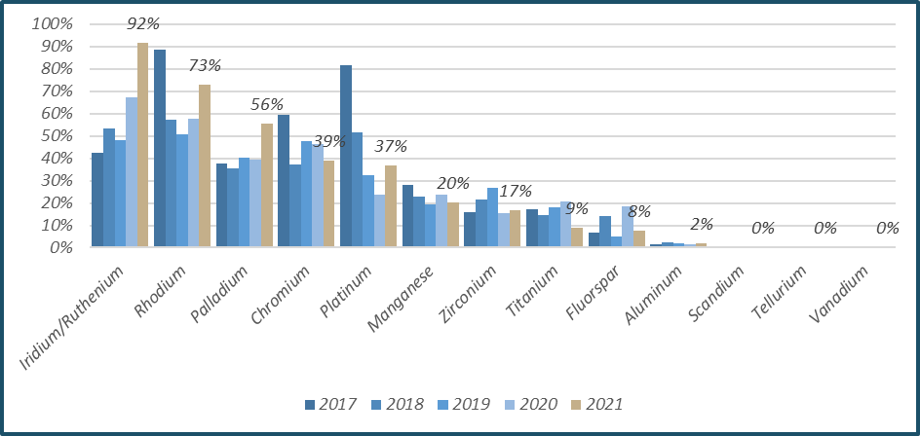
Jobs impact
Sector | AGOA exports
 | Direct jobs estimates
Manufacturing | 13 877
Agriculture | 5023
Mining | 430
Total (SA jobs) | 19 331
Indirect jobs in SA estimate (SA jobs) | 35 795
Jobs benefit from SA AGOA (USA jobs) | 18 000
Jobs benefit from total AGOA (USA jobs) | 155 000
Total trade SA with USA (USA jobs) | 61 720
Source: TIPS 2024, various reports and datasets
South African share of US imports of select Critical Minerals, 2017-2021
Source: CEPII, BACI (Base pour l'Analyse du Commerce International), 2022; USGS List of Critical Minerals 2022.

Slide 7
Utilisation of AGOA
Sector | Subsector | AGOA | Non-AGOA | AGOA Utilisation | GSP share
Agriculture | Fruit, Vegetables & Flowers | USD 231 389 611 | USD 22 953 709 | 91% | 2%
 | Agricultural commodities | USD 16 669 061 | USD 4 809 433 | 78% | 0%
 | Meat & livestock | USD 39 000 | USD 364 450 | 10% | 0%
Manufacturing | Automotives & transport equipment | USD 1 563 847 303 | USD 73 984 516 | 95% | 2%
 | Metals & Machinery | USD 520 361 119 | USD 400 190 880 | 57% | 13%
 | Petrochemicals | USD 353 138 767 | USD 158 211 906 | 69% | 18%
 | Agroprocessing | USD 167 745 166 | USD 80 001 982 | 68% | 5%
 | Electrical machinery | USD 9 378 341 | USD 35 157 390 | 21% | 27%
 | CTFL | USD 6 787 763 | USD 40 695 586 | 14% | 13%
 | Wood Products, Pulp & Paper | USD 1 853 273 | USD 6 654 790 | 22% | 47%
 | Professional equipment | USD 316 178 | USD 15 802 588 | 2% | 73%
 | Other manufacturing | USD 241 040 | USD 4 545 094 | 5% | 14%
 | Glass & Mineral Products | USD 144 041 | USD 1 483 035 | 9% | 17%
There are opportunities to expand South Africa’s utilisation of AGOA

Slide 8
AGOA Risks
Increasingly aligned to trade or political requirements to stay in (e.g. SA out of cycle review or Eswatini) – a process that can be mis-used / subject to lobbies
Not an FTA so ad-hoc negotiating mechanisms (incl. hearings in congress)
South Africa is a significant beneficiary of AGOA – less so for other African countries, esp. non-oil (SA half of non-petroleum manufactured exports under AGOA)
Five countries make up over 80% of exports under AGOA (SA (mix), Nigeria (oil), Ghana (mix), Angola (oil) & Kenya(agric&manuf))
Without AGOA preferences will our manufactured exports be as competitive in USA market?
Despite AGOA, majority of SA exports still commodities (PGMs, diamonds, gold)

Slide 9
AGOA opportunities?
A longer extension would see benefits in investing in developing exports to the USA
Investment by US firms into African countries to align with AGOA
Regional opportunities to grow exports (also regional growth is good for neighbours) + RVCs - can the four anchor markets support regional growth through AGOA
Tariff lines under AGOA are an opportunity to export increasingly complex / value add goods (AGOA provides space to support beneficiation & diversification of exports). But requires improved support measures …
Clear benefits to USA from AGOA – jobs created, new investment opportunities, access to critical minerals and growth in trade in services. These will grow with AGOAs continuation and strong bilaterial trade relations.

Slide 10
Conclusions
AGOA has helped improve SA exports to the USA
AGOA provides a platform to engage on trade issues in the absence of a trade agreement, and overall trade in growing
AGOA is beneficial for both SA & USA – trade, investment & jobs. USA has seen growth in trade in services (USA exports)
The total saving on taxes and jobs impact relatively small but strategic value in a very competitive trade environment, impacts on investment decisions – contributes to a positive impact in the face of many headwinds in SA manufacturing sector
AGOA provides the access but need for industrial policy to drive development to access the opportunities - trade policy alone will not achieve industrial development
There remains a strong development imperative to keep SA in AGOA

Slide 11
Thank you
- full paper available on TIPS Website www.tips.org.za

